Slide 1
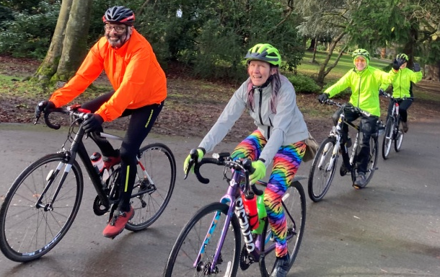
Cycle with CTC Coventry
Come along with us for Sociable, Supportive and Safe Cycling
We help new Riders get stronger, ride further and enjoy cycling more
We do up to three Recreational rides of different length on Sundays,
....and a range of Weekday and Offroad rides
We have an active Women’s Group with Women-only Rides and Tours
We hold several Short and Long Tours a year in the UK and Abroad
We are a Member Group of Cycling UK
Our Ride Leaders are all Experienced and Registered
to keep you safe.
Our Rides are suitable for a wide range of abilities
....and we will NEVER leave you behind !
If you are interested then check out –
Our email – Secretary@CoventryCTC.org.uk
Our website – www.coventryctc.org.uk
Our Facebook Page – CTC Coventry
Our Instagram – cyclewithctccoventry
If you enjoy your ride and want to cycle with us regularly then we ask that you join CyclingUK – there are lots of benefits !

